Slide 1
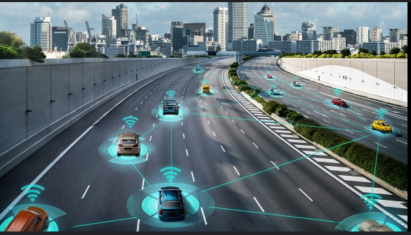

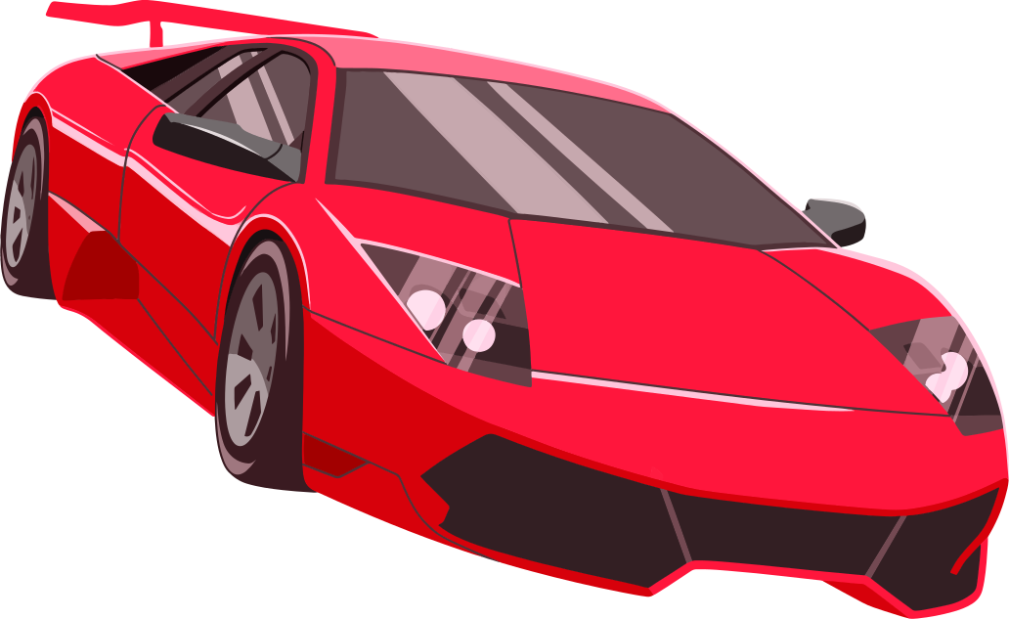



End-To-End Autonomous Driving.
Written and Prepared by:
Ola Akinkunmi

Slide 2


01
But what exactly is Autonomous Driving?
Autonomous Driving System is a complex system that integrates multiple fields (Electrical, Physics, Mechanical, Computer Science etc.) and Technologies ranging from Sensors/Hardware, Central Processing Units, Storage, Software, Networking, Artificial Intelligence, Cybersecurity etc.

Slide 3
Main Architectures for Autonomous Driving
Modular Approach
Hybrid Model
End-To-End Algorithm
This is sub-divided into two categories:
Mediated Perception: This involves training the Computer Vision algorithm with human knowledge of known Avoidances(Traffic lights, Road markings, Pedestrians etc.). The neural network handles decision making and vehicle control.
Behavior reflex: The neural network mimics human behavior in a supervised learning approach. To teach the model, a human drives the car on the road or in a car racing simulation game e.g. Grand Turismo Sports, while the system records images and steering angles as training data.
This is the classical method for Autonomous Driving in the industry. The overall Driving Task is divided into four modules.(Sensor, Perception, Decision Making, Control Commands) with each module responsible for various subordinate functions such as Lidar, Object Detection, Path Planning, Acceleration etc. It is also known as rule-based design.
This consist of two paradigms:
Reinforcement learning: This uses trial and error because it utilizes Deep Q Network (DQN) to maximize the cumulative rewards received by an intelligent system as it interact with the environment.
Direct Perception: This uses Deep Convolutional Neural Network (DCNN) to dynamically learn images for estimating Avoidances relating to Autonomous Driving in combination with Deep Q Network(DQN). Training data is also from human driver or car racing simulation recordings such as Grand Turismo.

Slide 4
Pros and Cons of each Architecture
Modular Approach
Hybrid Model
Mediated Approach
Hybrid Model
Behavioral Reflex
Pros:
Infusing human knowledge instead of letting the AI learn all relevant information from the scratch.
Modular Approach advantages.
Cons:
Redundant information as only a small portion of the objects detected are relevant to driving decisions.
Modular Approach Disadvantages.
Pros:
Easy to copy the surface level actions due to simplicity.
Elegance and Efficiency: The AV can react to various driving scenarios without complex-decision making process.
Cons:
Copycat problem: The model relies on wrong correlation between certain input components and output responses.
Behavior Reflex model cannot see the bigger picture as the decision making ability is too low for the situation.
Pros:
Enjoys a matured industry framework to connect the different modules.
A source of malfunction can be tracked to the module responsible for failure.
Cons:
Each module will fail to generalize about unfamiliar conditions due to hyper-specialization.
Error Propagation; A mistake in one module will impact subsequent modules.

Slide 5
Pros and Cons of each Architecture
End-To-End
Reinforcement learning
End-To-End
Direct Perception
Pros:
It is the currently the creative, flexible and best way to train and attain Generalized Artificial Intelligence.
It is multidimensional and similar technique is used in other fields like Art, Gaming, Language Models, Chemistry, Genetics, Autonomous Driving etc.
Cons:
Very data hungry during the training period.
Requires an environment that allows potentially unsafe actions to be performed during data collection.
Pros:
It is currently the safest and best way to logically attain Autonomous Driving.
Cons:
Initially relies on Human recordings or gaming environment to learn the Avoidances to base the future learning upon.

Slide 6

Out of the 5 levels of Autonomous Driving, we are currently in level 2. This also shows the difficulty of the problem. But with modern and future technologies(Quantum etc.), data and recent AI models starting in 2016 full autonomous driving might be achieved in a decade or two.
A major issue with End-To-End algorithms in Autonomous Driving is that most of the techniques have to be done in a close-loop environment such as Grand Turismo, AirSim, Carla etc. due to public backlash, but it should be noted that the open-loop environment exist such as Apollo, Mobileeye, Waymo etc.
Conclusion
Thank You!!

Slide 7
You can check out my GitHub for the rule-based code implementation or other works of mine: #GameOver #EndGame
https://github.com/privateboss0/Autonomous_Driving_Tongji_Uni
-Ola Akinkunmi

